Slide 1
Quality Assurance during Manufacturing, Assembly, Integration and Testing of Space Hardware
EPFL presentation for MAIT
(Manufacturing, Assembly, Integration and Testing)
8th of December 2025

Slide 2

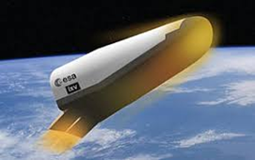
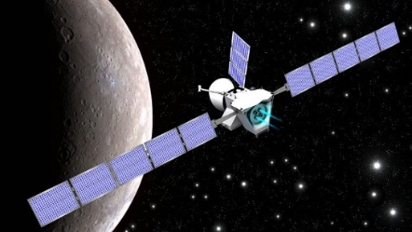
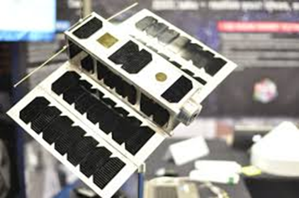
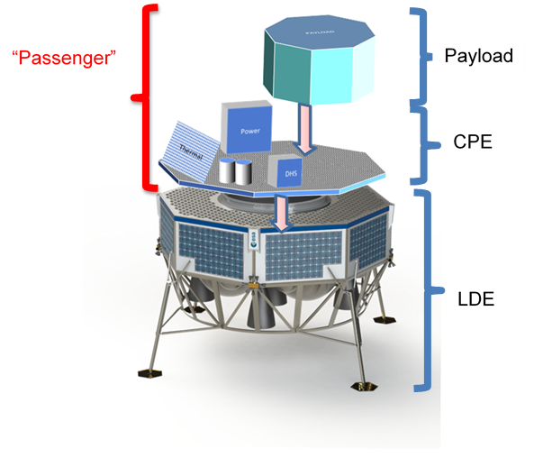
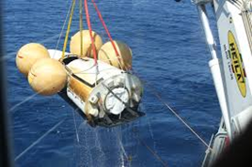

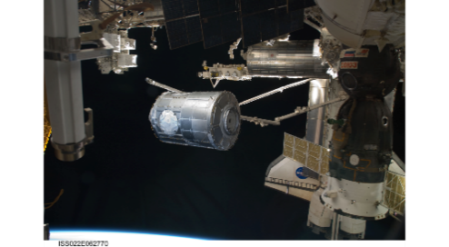
Pierre Brunner – EPFL Physics Engineering - PA/QA Engineer in QPM - @ ESA since January 2010
2010-2015 : Product Assurance Manager for IXV mission (Intermediate eXperimental Vehicle - Re-entry demonstrator)
2015-2019 : PA/QA Engineer at ESA launchers for FLPP (Future Launchers Preparatory Program)
2019-2025 : PA/QA Engineer at ESTEC in QPM for Argonaut and ArgoNET mission (cargo lunar lander), for Aurora-D borealis space weather satellite, for GSTP projects (General Support Technology Program), for ARTES projects, for ISS payloads, and recently for Greek National Program (small satellites fast developments).
Notes:
20 years in the industry before entering ESA – 15 years at ESA since 2010

Slide 3
Content of the presentation
Part 1 – Introduction
  Specificities of Universities Start-ups and SMEs
Part 2 - Generic objectives of PA/QA
  ECSS domains, Mission Classification, Project Life Cycle
Part 3 – Q-10 and Q-20 disciplines during MAIT
  PA plan, Product/Quality Assurance contents
Part 4 - Qualification process activities before MAIT
  EQSRs; CILs; Definitions of EM, QM, EQM, PFM; RAMS aspect
Part 5 – PA/QA Activities during MAIT
  Manufacturing Readiness Reviews MRRs and IRRs
  Inspections KIPs and MIPs
  Traceability, configuration, documentation
  NCRs and NRBs
  Test reviews TRRs / PTRs / TRBs
Part 6 – Example of project developments with SMEs
  PRODEX cases, GSTP cases with low TRLs, HRE developments, Greek National Program KIP/TRR examples.
Part 7 – Conclusion
  Q&A

Slide 4
I. Specificities of Universities Start-ups and SMEs (1)
While the specificities of Product Assurance and Quality Assurance can vary based on the nature of the mission, there are some general differences between Universities Start-ups, or Small and Medium Enterprises (SMEs) and large industry when it comes to spacecraft PA and QA.
  Resource Constraints:
  Limited financial and technical resources compared to large industry players may impact SMEs capacity to invest in Quality and Testing, they need cost effective Quality control solutions.
  Regulatory Compliance:
  Difficulty to comply with regulations and standards set by agency and international organisations ; SMEs may face difficulties in understanding and complying to the reqs due to lack expertise and limited experience.
  Documentation and Processes:
  SMEs may have less formalized processes and may need to adapt their existing systems.
  Large industry players typically have well-established and mature documentation and quality management processes, making it easier to ensure compliance and maintain quality throughout the spacecraft development lifecycle.

Slide 5
I. Specificities for Universities Start-ups and SMEs (2)
  Supplier Management:
  SMEs may face challenges in identifying and choosing suitable suppliers, as well as ensuring consistent quality standards from these sources. SMEs need to build a strong Suppliers ecosystem adapted to their products.
  Testing and Verification:
  SMEs may have limited access to environmental chambers, vibration tables, and thermal vacuum chambers facilities and may need to rely on external testing services, which can introduce additional costs and coordination efforts.
  Risk Management:
  Large industry players often have well-defined risk management processes and dedicated teams to identify, assess, and mitigate risks throughout the project lifecycle. SMEs may face challenges in allocating resources for on-time comprehensive risk management activities with PA support.

Slide 6
I. Potential Advantages of Universities Start-ups and SMEs (3)
But there are advantages for SMEs:
  Knowledge and competences may be less “compartimented” (separated in different sections/divisions) than in big industrial players ; therefore SMEs may have stronger efficiencies in Quality, and a better return of investment value for their PA/QA referential implementation.
  The application of the ECSS standard may be easier when focused on specific products. SMEs can achieve excellency faster in their specific domain with their specific products with adequate ECSS tailoring.
  SMEs may also be more likely to evolve faster and adapt better to the evolving requirements of space manufacturing.

Slide 7
II. Mission classification – ECSS tailoring based on risk tolerance
In the updated ESA Mission Classification : 4 different mission classes have been identified.
Criteria are : Mission criticality toward agency strategy, Mission objective, mission lifetime, mission complexity, mission cost.
More flexibility is given to industry as a function of the class of the mission (highest flexibility and associated risk for Gamma and Delta).
Cubesats
New Space
Notes:
Mission classification was introduced recently for the PA/QA requirements tailoring of ESA projects

Slide 8
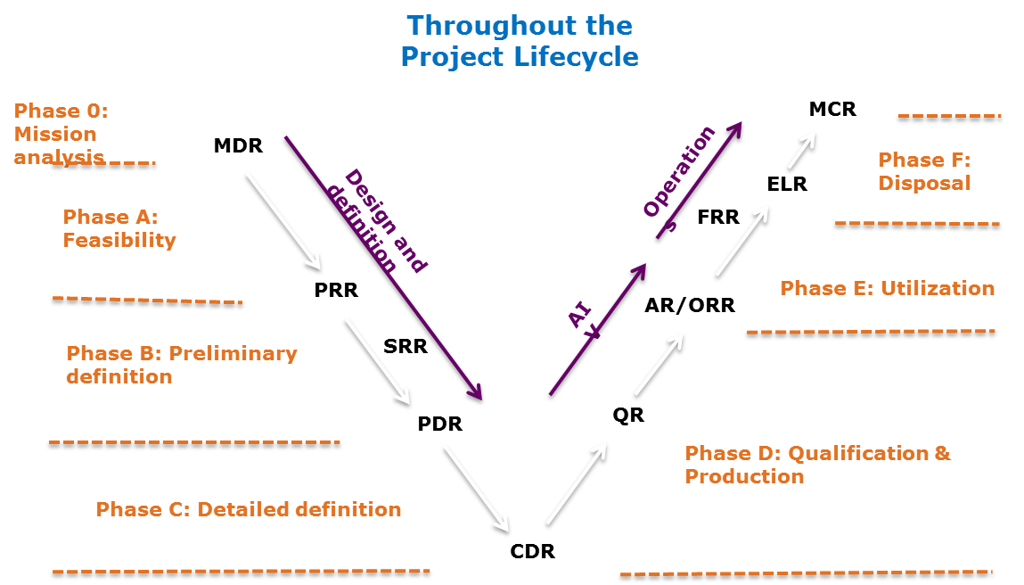
II. Project life cycle
MAIT
Notes:
RAMS, EEE, Materials and Processes to be performed/initiated more in Design and Definition phases
Quality Assurance to be performed more in the MAIT phase
MAIT stands for Manufacturing, Assembly, Integration and Testing
Phase D (Qualification and Production) - between CDR and AR

Slide 9
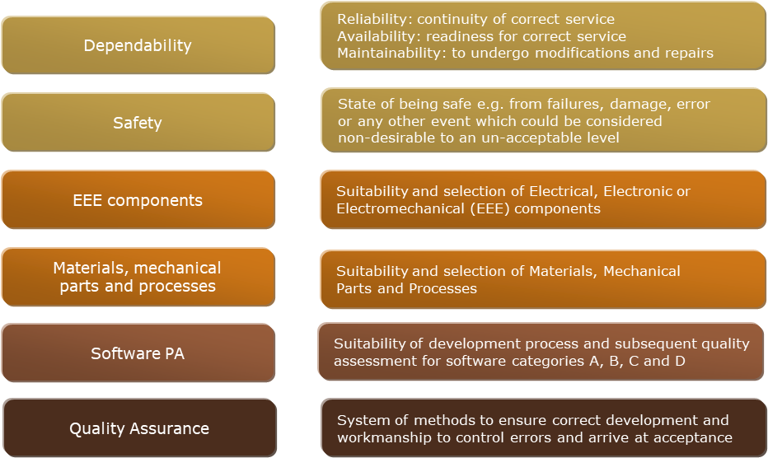
II. Domains of QA vs Product Assurance
Verification of the qualifications in the different domains during MAIT
QA is a discipline of Product Assurance
Notes:
RAMS, EEE, Materials and Processes to be initiated in Design and Definition phases

Slide 10
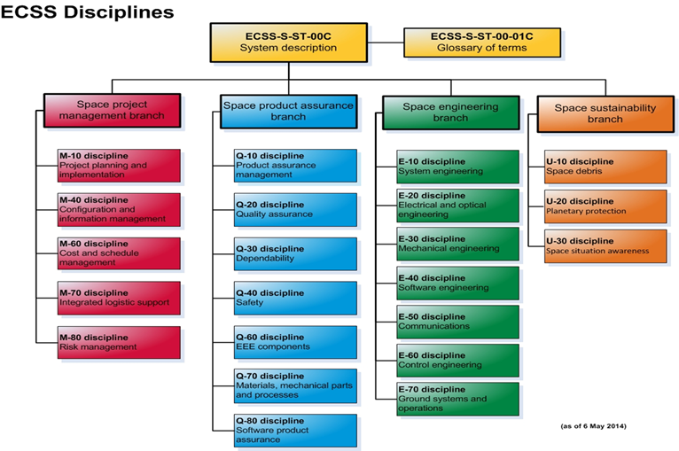
II. ECSS Key Elements of Product Assurance
o Supplier Evaluation and Auditing
o Reliability and Safety Assurance
o Failure Modes and Effects Analysis
o Reliability Testing and Analysis
o Safety Compliance
o Design and Development Assurance
o Design Verification and Validation
o Component and Material Selection
o Engineering Analysis and Simulation
➔ Highlighted for MAIT
o Manufacturing Process Assurance
o Process Control and Monitoring
o Inspection and Testing
o Configuration Management
o Quality Assurance and Control
o Documentation Control
o Non-Conformance Management
Notes:
I will focus on the MAIT phase
MAIT stands for Manufacturing, Assembly, Integration and Testing
Phase D (Qualification and Production) - between CDR and AR

Slide 11
III. Product/Quality Assurance plans contents
PA PLAN (ECSS-Q-ST-10 Annex A):
PA organization, responsibilities and authority, resources, PA interfaces & processes
PA implementation procedures, including:
  PA & risk management and reporting
  PA audits
  Critical items
  Document & data control
  Quality records
  PA contribution to CC
  NCRs & Alerts management
QA PLAN (ECSS-Q-ST-20 Annex A):
QA processes and procedures including training and certification
Design and verification QA activities and processes Procurement QA activities and processes
Manufacturing, assembly, integration (MAIT) and testing QA activities,
QA specific activities, including:
  Critical items, NCRs & Alerts
  Authority media, Traceability, Records
  Metrology and calibration
  Handling and storage
  Statistical quality control
Notes:
Importance of the PA plan
PARD definition phase
Categorisation of projects…

Slide 12
IV. Highlights of some important qualification process activities before MAIT
EQSRs
CILs
Definitions of EM, QM, EQM
Note: RAMS, EEE and M&P shall be considered in detail before MAIT (see RAMS specific presentation)

Slide 13
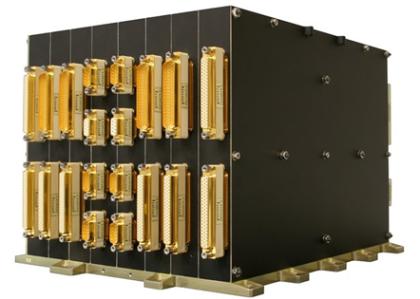
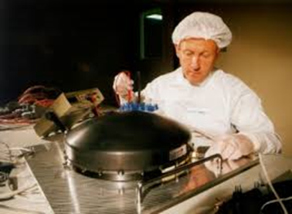
1. Equipment Qualification Status Review
EQSR: Equipment Qualification Status Review (ESSB-M-ST-002)
Determine Qualification Status (Category A, B, C or D)
Identify changes to unit functionality
Identify flight Heritage
Identify Obsolescence
Identify changes in manufacturing processes
Compliances to PA and development standards
Identification of developments models (ex: EM, EQM, QM, PFM)
to be manufactured and tested for the program project
Notes:
EQSR is a very powerful methodology to identify the heritage and the necessary delta-qualification needed to use a product for space
- Identification of developments models (ex: EM, EQM, QM, PFM) to be manufactured and tested for the program project
The classification of the Equipment Qualification Status is usually defined according to the categories definitions:
❖ Category A: Off-the-shelf product without modifications and subjected to a qualification test programme at least as severe as that imposed by the actual project specifications including environment and produced by the same manufacturer or Supplier and using the same tools and manufacturing processes and procedures. Fully Recurring equipment, fully identical to one already qualified for comparable mission environmental requirements.
❖ Category B: Off-the-shelf product without modifications. However: It has been subjected to a qualification test programme less severe or different to that imposed by the actual project specifications (including environment). Recurring equipment with Limited Changes, minor modifications to the existing configuration. Delta design or delta qualifications are needed on a case-by-case basis.
❖ Category C: Off-the-shelf product with modifications. Modification includes changes to design, parts, materials, tools, processes, procedures, Supplier, or manufacturer. Modified Equipment, formal design reviews and a delta or full Qualification program are needed. Changes in the environment may also impact the qualification.
❖ (Category D: Newly designed and developed equipment. A full qualification test program shall be performed. It should be noted that this checklist is not applicable to equipment of category D “New Equipment” needing a full qualification).

Slide 14
2. Critical Item Control
The items shall be kept in the CIL which lists the mitigation actions and criticality of the item. Refer to ECSS-Q-ST-10-04 §5.1
The identification of critical items is done by the supplier as soon as a preliminary design emerges, first issue of CIL at Preliminary Design Review.
The CIL shall be reviewed during the design reviews and all listed critical items shall be closed by the acceptance review after MAIT.

Slide 15
2. Critical items –
Examples
ECSS-S-ST-00-01C – Critical item: potential threat to the schedule, cost, performance and quality of a project or programme that is controlled by a specific action plan in order to mitigate emanating risks and to prevent undesirable consequences
General
has the potential to degrade the mission objectives
may lead to major difficulties at any point of the project life cycle
RAMS critical items
a residual single­ point failure (SPF)
fracture critical item
not meeting applicable derating requirements
as shown by worst case analyses
Critical components, materials and processes
Long lead items
EEE components subject to export licence constraints
EEE components sensitive to radiation environment in space
components, material and processes new or not qualified / validated for intended application
with a known history of flight failures
Software critical items
not modifiable in the operational environment
with strong complexity
development tools with limited maintenance with respect to mission lifetime
Notes:
CIL is a powerful tool to mitigate risks

Slide 16
3. Definitions of EM, QM, EQM and PFM
• Models shall be selected defining the optimum number and type of physical models required to achieve a high confidence in the product verification with the shortest schedule and a suitable weigh of costs and risks
• The are various types of models and model philosophies. Their applicability depends on the specific project requirements
• Model philosophy shall be defined early in the project and frozen as soon as possible due to its impact on the project implementation
Preliminary FlatSat model for functional EEE interfaces and communication tests.
Structural Model (SM) - It is used for qualification of the structural design and for mathematical models correlation.
Thermal Model (TM) - It is used for the qualification of the thermal design and for the correlation of mathematical models.
Engineering Model (EM) – It is flight representative in form, fit and function, without full redundancy and hi-reliability parts.
Qualification Model (QM) – It is used for full level functional and environmental qualification tests.
Engineering Qualification Model (EQM) reflects the design of the flight model except for the parts standard, used for functional performance and EMC verification – EQM is possibly used for qualification.
Proto-Flight Model (PFM) - is the flight end item on which a partial or complete proto-flight qualification test campaign is performed before flight.
Flight Model (FM) - The flight model is the flight end item configured.
Notes:
EM or EQM allows to reduce risks that can occurs during Vibration and TV testing, all M&P can also be properly qualified…
EQM model fully reflects the design of the flight model except for the parts standard, used for functional performance and EMC verification and possibly for qualification
Engineering Qualification Model (EQM): This is the model that is subjected to the qualification campaign. This usually includes design updates from the EM and uses identical components to flight; however, these components do not need to be screened to the flight standard
What is the difference between FM and PFM?
Protoflight Model (PFM): Flight model on which a partial or complete proto flight qualification test campaign is performed before the flight. Flight Model (FM): End product that is intended for flight
FlatSat model for testing electronic interfaces, communication and grounding, with mechanical housing and electronical components (PCBs).

Slide 17
V. Product Assurance Activities during MAIT
o Manufacturing Readiness Review (MRR)
o NCR process (NRB process)
o Integration Readiness Review (IRR)
o Quality Inspections and Testing (KIPs and MIPs)
o Environmental Testing (TRRs, PTRs, TRBs)
o Documentation Control and Configuration Management

Slide 18
V. PA Activities during MAIT
Manufacturing Readiness Review
  Clean room check (entry, clothing, cleaning, environmental monitoring, ESD, training) ; Materials (Safety / dangerous items)
  Materials and processes qualification status
  Shop traveler, step-by-step instructions if possible
  Training

Slide 19
Manufacturing Readiness Review (2)
MRR is established as a step to verify that all the processes are in place and in acceptable conditions to successfully perform Manufacturing of the Equipment.
Perform the Manufacturing successfully is verifiable only in one way : it sets the preconditions in order for the successive phase : the TRB, is successfully performed.
Therefore, it has to be consistency checked against the ECSS-E-ST-10-02C Verification standard
MRR success criteria are:
to review and approve the manufacturing plan and procedures
to assess if the relevant equipment is ready for manufacturing (row materials, trained/certified personnel, calibrated manufacturing equipment, WI and procedures availability)
to assess if the relevant facilities are ready for manufacturing
to identify all open issues
to release the starting of Equipment Manufacturing

Slide 20
Manufacturing Readiness Review (3)
Is the CIDL provided?
- to verify that the manufacturing baseline is complete and that any differences between the qualified baseline and the manufacturing baseline are identified.
Are the PARTS, MATERIALS AND PROCESSES provided ? Are the DML, DMPL, DPL and DCL approved? ( to assess the verification/qualification approval status)
VISIBILITY of the heritage of the qualification processes ? (automated processes, Additive Manufacturing, etc.)
- Are the MPCBs and PCBs approved and closed?
Has MPCB report provided?
- Is the MPCB status approved?
- Are the status of RFA, on going parts, material or process validation approved? Are critical Process being analysed by relevant specialists? Are RFAs present to justify the Critical Processes?
- Are open RFAs impacting the Manufacturing activities for Flight Unit or Fit Form & Function similarity for Qualification Unit? (e.g For EMs, if not impacting critical function, can be acceptable to go on with open RFAs)

Slide 21
V. PA Activities during MAIT
Integration Readiness Review (IRR)
The objectives of the IRR are to validate all prerequisite conditions are satisfied and to authorize the integration of the item/unit at higher level:
- Verify the status of the unit is compliant with the expected one (if not, all deviations shall be traced and agreed)
- Verify that means and tools and associated procedures are available and approved, verify that operators are certified
Is the scope & Objective of the IRR clearly defined (mechanical/electrical activity, temporary/dummy or final unit installation, interfaces etc
Are the roles & responsibilities defined ?
Is a Plan for the activities in the scope of the IRR provided at the IRR review?
Are Assembly Integration Procedures and possible updates of specifications been reviewed and released?
Is all personnel available? Is any certification needed?
Notes:
MRR or IRR can be performed – depending on the project …

Slide 22
V. Important PA/QA Activities during MAIT Manufacturing/Assembly/Integration/Testing
1. Inspections (Mandatory Inspection Point (MIP)/Key Inspection Point (KIP)
    MIP: Customer must be invited
    KIP: Customer participation is optional
2. Tracability
3. Non conformance report (NCR) handling
    Criticality identification and Root cause Analysis
4. TRRs / PTRs (for example for Thermal Vacuum, and Vibration/Shock testing)

Slide 23
1. Inspections (MIPs/KIPs)
Inspections that give maximum visibility and consist of:
-Physical Item inspection
-Review of documentation related to the item - with a prepared tailored checklist…
  Expected configuration (as-built vs as-designed)
  Logbooks including Mate/Demate records
  Calibration documents
  Test reports
  Open Items and non conformances status
  Red/Green tag items lists
  Inputs for VCD verification…
Note: Mandatory Inspection Points involve the customer (Notification of 10 days according to ECSS)

Slide 24
2. Traceability (1/2)
    Traceability covers many type of activities :
    Requirements/verification traceability (e.g VCD)
    Materials and parts traceability (e.g. procurements documentation)
    Machine/operator/metrology traceability

Slide 25
2. Traceability (2/2)
    Traceability is important information
      Investigating a non-compliance (NCR process)
      Assessing whether a system is within the perimeter of an alert
      Data collection for routine monitoring of quality (correlation)
      Containment and segregation of unsuitable materials or parts
    Traceability documentation is found throughout
      As-built configuration list (ABCL) → in EIDP
      As-built declared component lists (DCL)
      Shop travellers or as-run procedures
      Inventory lists
      Declared Materials and Processes (DML, DPL)

Slide 26
3. NCR Process
When non-conformance is identified, a Non-Conformance Report (NCR) is raised. An example report in Annex C in ECSS-Q-ST-10-09C Rev1.
Assessment of NCR is performed in a Non-Conformance Review Board (NRB), mandatory participants PA and representative engineering.
Key aspects to cover:
Which item/model is affected
Criticality (Major/Minor)
Root cause evaluation, Corrective/preventive actions
Determine the disposition - whether to return to supplier/use-as-is/rework/repair/scrap

Slide 27
3. Nonconformance review board (NRB)
Internal NRB tasks
Investigate the causes and consequences of the NCR and classifies the nonconformance either as minor or major
For minor or major NCR the different disposition are as follows:
Use “as is”: The item is found to be usable without eliminating the nonconformance.
Rework: The item is recoverable to conform completely to all specified requirements. Additional work is performed to prepare the item for the rework (e.g. removal of faulty work and cleaning). In no case should the result of earlier applied processes or the precondition for other processes to be applied later on, be affected.
Scrap: The item is not recoverable by rework or repair, for technical or economic reasons.
Repair: The item is recoverable such that it fulfils the intended usage requirements although it does not conform to the originally specified requirements.
Return to supplier: This disposition only applies to non-conforming procured items.
Note: The repair procedure is either a. Qualified or standard repair procedure or b. Specific repair procedure.

Slide 28
3. Nonconformance review board (NRB)
Customer NRB – Major NCR
The customer NRB follows the same process as the internal NRB.
An assessment whether requirements of higher level customers reqs are impacted is performed.
If so, these higher level customers are involved in ensuing NRBs. The need for a request for waiver is also identified and recommended by this NRB.
To be noted that Level 2 disposition (Lessons Learned) can also be discussed during NRBs.
Lessons Learned Log shall be an output of the NCRs history data, and NRB treatments.
Notes:
We learn a lot with NCRs and Lessons Learned of NRBs

Slide 29
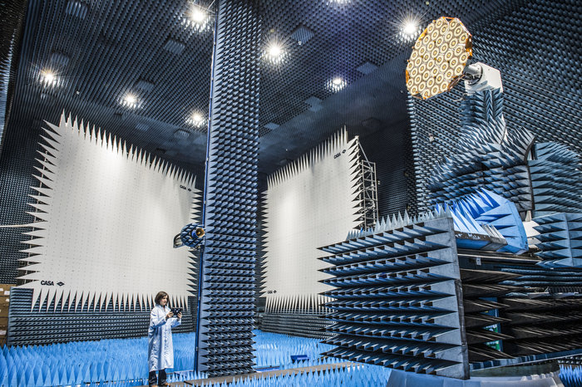
4. Test reviews
Facility Readiness Review (FRR) – by Test centre
Test Readiness Review (TRR)
  Test documentation
  Test item configuration
  Test configuration & set-up
  Facility readiness: calibration, cleanliness
  Personnel qualification & availability
  NCRs & waiver status, open work
Post Test Review (PTR)
  Test completeness: all data acquired & recorded
  Deviations, anomalies and NCRs raised
  Test-item configuration after test
  Open points and actions for closure
Hybrid European RF and Antenna Test Zone

Slide 30
4. Importance of TRR and PTR during MAIT
Test Readiness Review (TRR)
  Does the test facilities meet the test requirements?
  Are test procedures ready and formally released?
  Is the unit under test configuration complete?
  Is all test equipment calibrated?
  Have all open anomalies been processed?
  What are the open work items ? (open state of the activities)

Slide 31
4. Importance of TRR and PTR during MAIT
Post Test Review (PTR)
  Is the as-run complete?
  Have all variations been red-marked/recorded in process variation sheet?
  Are all NCRs formally tracked?
  Have test objectives been met?
  Can the test set-up be broken?
  Can next test start?

Slide 32
4. Importance of TRR and PTR during MAIT
Test Review Board (TRB)
Held to review all results and conclude on:
  Test completeness (test data availability and data storage ?)
  Achievement of objectives (success criteria fulfilled ?)
  Lessons learned (NCRs closures, potential RFDs to be issued ?)

Slide 33
VI. Case studies
o Highlights of examples of Product Assurance in action for GSTPs developments and PRODEX instruments.
see the previous examples of EQSRs, CILs, TRR and PTR reviews , and NCRs management during MAIT.
o PA added value for the successful sub-systems developments, showcase the impact of Product Assurance on mission outcomes
    MAIT support during testing with TRRs/PTRs/TRBs (e.g SPEXone optical instrument)
    TRL development for GSTP (e.g robotic manipulator)
Product Assurance is a key determinant factor for mission success ; it is a very important element toward a robust PA design, an adequate QA managed MAIT, a suitable properly qualified Product, and a successful mission.

Slide 34
Example 1 of MAIT support during testing with TRRs/PTRs/TRBs
With checklist and templates of TRRs and PTRs for PRODEX scientific equipment projects (for Science projects):
For EMC tests
For Vibration and shock tests (launcher reqs to be considered)
For Thermal Vacuum tests (temperature range mission dependant)
For Functional tests before and after testing
Notes:
TVAC to qualify gluing processes for example

Slide 35
Exemple 2 of Greek National Program : KIP example
KIP :
(before TRR)
KIP documentation / Traceability
Item | Remarks
Materials | No DML available. The outgassing properties are known for the different units.
Mechanical parts | CAD is describing this, including all changes propagated.
Processes | New processes are tested on non-flight equipment before being tried on proper flight equipment.
Past inspections | n/a
Record of operation time | Whenever the terminal is open to communicate with the spacecraft, this is being logged.
Connector mating cycle records | No logs. ESA recommended to implement this at least for connectors with limited mating cycles.
Battery charging records | Will be implemented
Mass and Dimensions Verification Report | To be done.
Assembly and Integration Log (As-Run) | The activity is being properly logged, the log will be provided at TRR.
Assembly and Integration Photos | Will be provided at TRR (as part of assembly and integration log).
Non-conformances and open work
Item | Remarks
NCR status list | Will be reported at TRR
Open NCRs affecting the start of the tests | There are no issue currently opened.
Open work to be done | No work related to NCRs, but assembly is not finished yet.
GNP: Seven CubeSat missions that demonstrate a variety of services including connectivity and secure communications are being developed by small and medium-sized companies and universities in Greece.
Notes:
Seven CubeSat missions that demonstrate a variety of services including connectivity and secure communications are being developed by small and medium-sized companies and universities in Greece.
ACTION examples following the KIP:
- ERMIS team to check the voltage of the BP8 battery packs and charge if needed. A charging log will be implemented.
- ERMIS team to configure P80 latch up limiters.
- ERMIS team to open NCR on the OQ payload RF frontend related latch-up events and subsequent design change.
- ERMIS team to perform the E2 solar panel incoming inspection as soon as possible.
- ERMIS team to request all ELM results and attach to report or perform test themselves as per GOMSPACE procedure.
- ERMIS to compile the DML.
- ERMIS to perform the MDV on E1 and E2 and provide report to ESA.
- ERMIS to provide the Assembly and Integration Log to ESA.
- ERMIS team to replace one of the RF cables which was damaged on the TR600 in E1
- ERMIS team to check connector on the SRS4 of E1

Slide 36
Example 3 of Lessons Learned : Historic A4 V36 failure origin…
  What happened during V36 in 1990 ?
  Operator had to interrupt the pipe assembly procedure
  Believing well, he put a rag in the open tube to avoid pollution... Being clearly visible, no problem, he thought.
  The cloth slipped into the pipe !
  The person who continued the operation was not aware ... and mounted the rest of the pipes ...
  One of the engines stopped working when the rag prevented the flow of coolant - The launcher tried to compensate but disintegrated when trying to correct trajectory ...
  ➔ root cause was the lack of communication
Notes:
ARIANE 4
V36 : Au cours du 36ème , le 23 février 1990, la fusée explosa au large des côtes guyanaises, entraînant la perte de deux satellites japonais, Superbird-B et BS-2X. Cet accident était dû à la présence d'un chiffon oublié dans une canalisation de l'un des quatre moteurs Viking du premier étage et à une fuite de carburant sur un propulseur d'appoint.
La présence de ce chiffon "oublié" relance les hypothèse de sabotage sur le lanceur européen. Le raport d'enquête qui ne remet pas en cause le programme préconise 44 recommandations pour éliminer tout risque qu'un corps étranger ne se glisse dans Ariane. Il n'y a pas eu de "sabotage" mais négligence déclare le Cnes. reste à emettre des hypothèse sur la manipulation qui a conduit ce chiffon à se retrouver là.
https://www.capcomespace.net/dossiers/espace_europeen/ariane/annexes/annexe8_echecs_ariane.htm

Slide 37
VII. Conclusion
➔ The tailoring of Q-10 (PA management) and Q-20 (Quality Assurance activities) provides a robust framework for space manufacturing and testing also for SMEs.
➔ The added values of the ECSS implementation for SMEs may be even greater than for large industrial players.
➔ The importance of Product Assurance
➔ PA Management is a key support to Project Management…
➔ PA/QA implementation facilitate the road to mission success…
➔ Call to Action for Implementing Product Assurance in Satellite and Spacecraft Manufacturing
➔ Advise to take advantage of all the PA/QA heritage of the past experiences through the ECSS standards and the QA/PA reqs implementation…

Slide 38
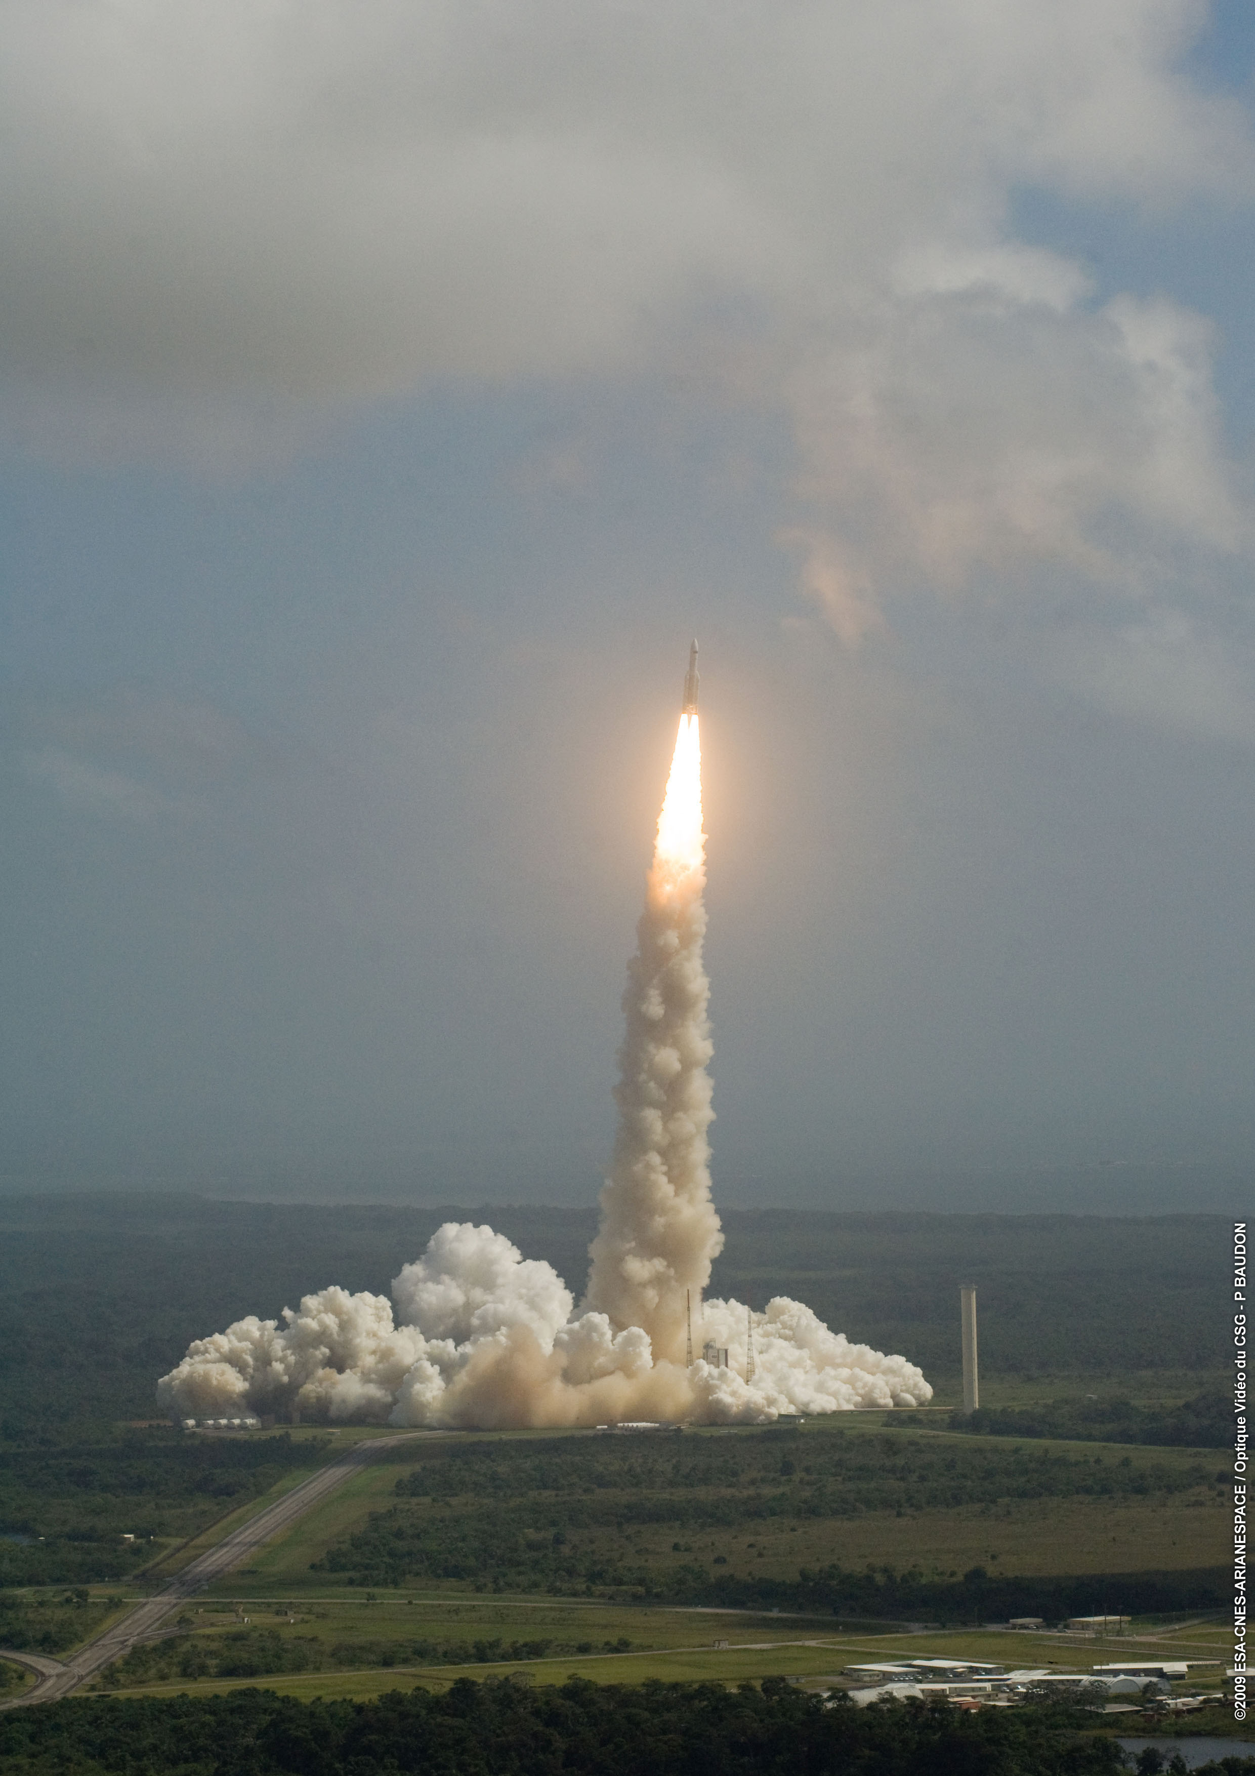
Quote(s)
Excellence is never an accident. It is always the result of high intention, sincere effort, and intelligent execution”
Aristotle (Greek philosopher, 384-322 BC)

Slide 39
Q&A session
[Q&A]
o Address audience questions and concerns
Thank you for your attention

